Slide 1
SUMMARISING…
Getting to the Point
TO CUT THE LONG STORY SHORT…by Niki D.Christodoulidou

Slide 2
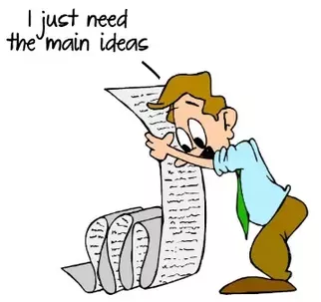
WHAT IS A SUMMARY?
A summary :
is a short retelling of a story, nonfiction text, media, or events, experience etc. which retains the essential information of the original
is a fairly brief restatement --- in your own words --- of the contents of a passage
could be a single paragraph or a multi-paragraph summary.
So, Summarising is all about:
Keeping: Keep only the important information and main ideas.
Deleting: Do not include supporting details in your summary.
Paraphrasing: Use your own words!!!
Note: you simply report back what the writer has said, without making value judgments.

Slide 3
WHY IS IT IMPORTANT?
You summarise every time you tell friends about an experience, a book you read,
a story you heard or a movie you saw.
You can't tell everything, so you tell what's most important:
the main idea(s) and a few details.
The length of your summary depends on the length of the text you are summarising.
(approximately 1/3 of the original text)
AND FOR STUDENTS?
…helps you learn to determine essential ideas and consolidate important details
that support them.
…enables you to focus on key words and phrases of an assigned text that are
worth noting and remembering.
…teaches you how to take a large selection of text and reduce it to the main points
for more concise understanding.

Slide 4
HOW TO GO ABOUT…
State the main idea(s) of the article or text - the key concept.
Why?
Establish(es) the topic
Establish(es) the author's point of view
Drive(s) the text – determine(s) what it contains and why.
Identify the most important details that support the main ideas - what the author wants us to understand
Write your summary in your own words, except for quotations.
Express the underlying meaning of the article, not just the superficial details - the “life lesson” we should take away from the text.

Slide 5
A GOOD SUMMARY …
has a main idea/concept
includes important facts and details
is in the writer’s own words
reflects underlying meaning
includes details in logical order
A SUMMARY DOES NOT INCLUDE…
your opinion
what you think the author should have said
copied material or a string of quotes from the selection

Slide 7
SO, LET’S THINK…
“How long are the Harry Potter movies? Yes, over three hours.
If someone asked you tell them about Harry Potter movies, would you talk for three hours?
Of course not! What would you do?”
Summarise the plot!!
***This will get you focused on the notion of summarizing as something you actually do in your
everyday lives.

Slide 8
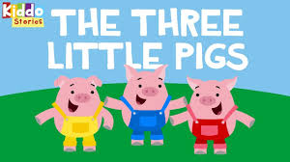
Look at this picture. You are all familiar with the story/fairytale…
TASK 1:
Write down the title and anything you know or can recall about it (free writing - just key words/concepts or chunks of info).
Try to link your notes in a cohesive paragraph.

Slide 9
SAMPLE ANSWER
“Once there were 3 little pigs who decided to build their own houses. A wolf looking for food found the three pigs, each one having their own home made of straw, sticks and finally, bricks. The wolf knocked on each door, threatening to blow their house down. The pigs with the straw and sticks fell victim to the wolf's threat. The homeless pigs took refuge in the third pig's house who took its time to build a brick house. The wolf puffed and puffed but couldn't get this house down. The wolf entered the chimney but the clever pig boiled a pot full of water, pushed it under the chimney and waited for the wolf to fall into it. The wolf got burned and the pigs lived happily ever after”.

Slide 10
TASK 2: Read the text below and create a word cloud or a mind map with the key information
Computers have become a necessity for both small and large businesses today. It takes a computer less than a second to retrieve information that takes a person several hours to obtain. It is for this reason that banks, airlines, and fast food restaurants rely so heavily on them. In addition, computers can store large amounts of data in a relatively small space. Because of this, offices need less storage space equipment such as file cabinets and supply store rooms.

Slide 11
IDEA/TOPIC SENTENCE
Computers have become a necessity for both small and
large businesses today.
speed in information retrieval
store large amounts of information of data

Slide 12
COMPUTERS
Important for small and large business
store large amounts of
information of data
speed in
information
retrieval
Summary
Computers are important for both small and large businesses because of their speed in retrieving information and their ability to store large amounts of data in small spaces.

Slide 13
TASK 3:
A. Read a short passage. This can be either a short essay or part of one.
(Some suggestions are short expository readings from the fields of entertainment, science, education, or history).
B. Underline the main ideas as you read
C. Locate / Highlight important details
D. Write down what the text is about
E. Write down the Key idea(s)
F. Paraphrase info
G. Put info/ideas together.

Slide 14
*How to put ideas together….
Work on ordering the sentences and connecting them with transition words. Since the main ideas are drawn from different sections of the text and distinct from each other, it is important to connect them.
*Paraphrase the sentences.
An important concept related to summarizing is changing the summary significantly from the original. Change the grammar and vocabulary of the sentence.
*Language of summaries.
Use language used in summary writing, such as the phrase “According to the author/text”, ‘’the author proposes…’’ etc

Slide 15
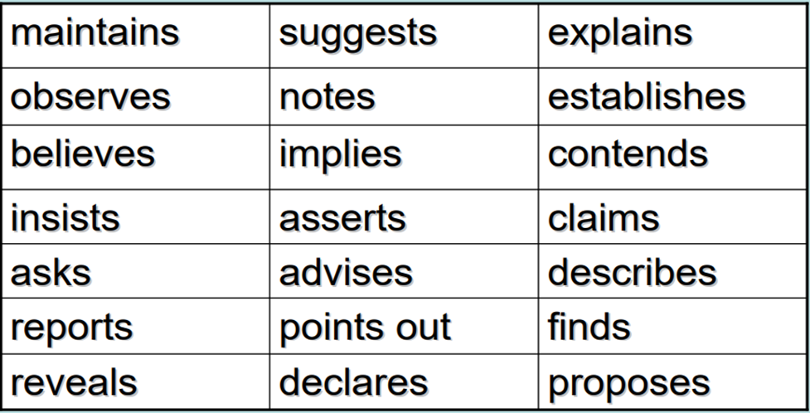
Other words you can use instead of “says ” or “tells ” or “talks about talks about”

Slide 16
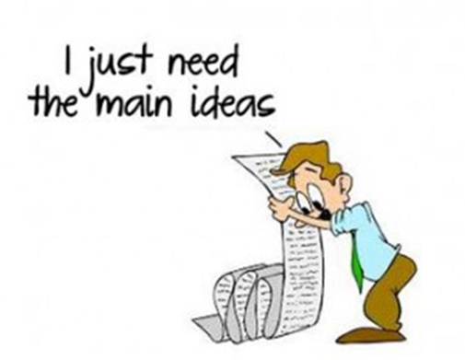
Your summary ‘check list’….
Highlight the key words/information in the text
Organize the ideas in a word Cloud or a mind map*
Use the words to write sentences - Never use your own ideas, opinions, or interpretations into the summary.
Write the title of the text, the author – if mentioned, and main idea in the present tense.
Open your summary using a strong verb e.g. suggests, explains, discusses etc
* Word clouds and mind maps are useful strategies to organize information

Slide 17
Make sure your summary answers the following questions:
What is the text about?
Why has the writer written the text? (to explain, present, discuss etc)
What does the writer/text say about it?
How does it say it?

Slide 19
FURTHER PRACTICE TASK 4:
Read the following article carefully.
Identify the main idea.
Annotate / Underline & number the essential details.
Make a mind Map / word cloud
Locate the writer’s conclusion
Write a summary.

Slide 20
Learning Languages
One of the most important characteristics of successful language learners is their willingness to make mistakes. Young children learn their first language by trying to communicate a message rather than by trying to learn grammar rules. Children are not worried about correctness, they are concerned with the message. The message is more important than the grammar. In the same way, second language learners must try to communicate even when they are not certain of the correct forms or words. By using the language to communicate, their language skills will improve. For example, if someone else cannot understand what the learner is trying to say, then the learner must change the way he or she is using the language. In this way, the learner quickly learns what is correct and what is incorrect. Mistakes become learning opportunities. Therefore, the more learners use the language, the more skilled they become in the language. Successful language learners do not wait until they can speak or write perfectly before they use the language; they use the language in order to improve their speaking and writing.

Slide 21
Congratulations! You are now well prepared to write a well organized summary!

Slide 22
SOURCES
http://homepage.smc.edu/reading_lab/writing_a_summary.htm
http://user.keio.ac.jp/~hjb/How_to_write_a_summary.html
http://academics.smcvt.edu/cbauer-ramazani/AEP/EN104/summary.htm
www.curriculum.org/secretariat/files/Jan30TURubric.pdf
www.fremonths.org/ourpages/auto/2006/8/20/.../Summary%20Rubric.doc
Burke, Jim. Tools for Thoughts. Portsmouth, NH: Boynton/Cook Publishers, 2002.
Crain, Hilary, et. al. The Write Path: Teacher Guide for English Language Arts, Middle Level through High School. AVID Press, 2002.
Wormeli, Rick. Summarizing in any Subject: 50 Techniques to Improve Student Learning. Alexandria, Virginia: ASCD, 2005.

